Slide 1






CAN YOU REMEMBER?
Let’s see if we can test your memory, and see if you can remember some of the key points from the videos.
Then we will you will expand on you knowledge!

Slide 2

As a class, can you guess which food groups contain fibre to support your digestive system?
1
  2
  3
Vegetables
Fruit
Meat
4
  5
  6
Carbohydrates
Fats
Beans and Pulses

Slide 3


Well done if you said any of the answers below!
1
  2
  3
Vegetables
Fruit
Meat
4
  5
  6
Carbohydrates
Fats
Beans and Pulses

Slide 4

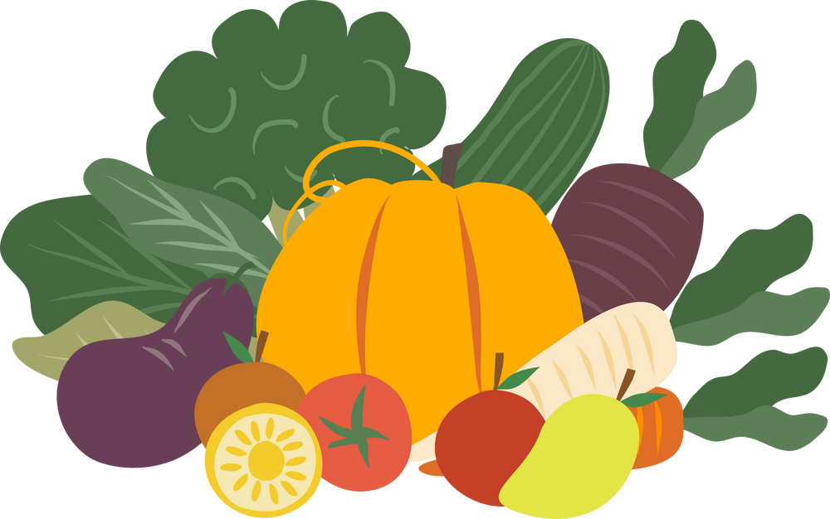
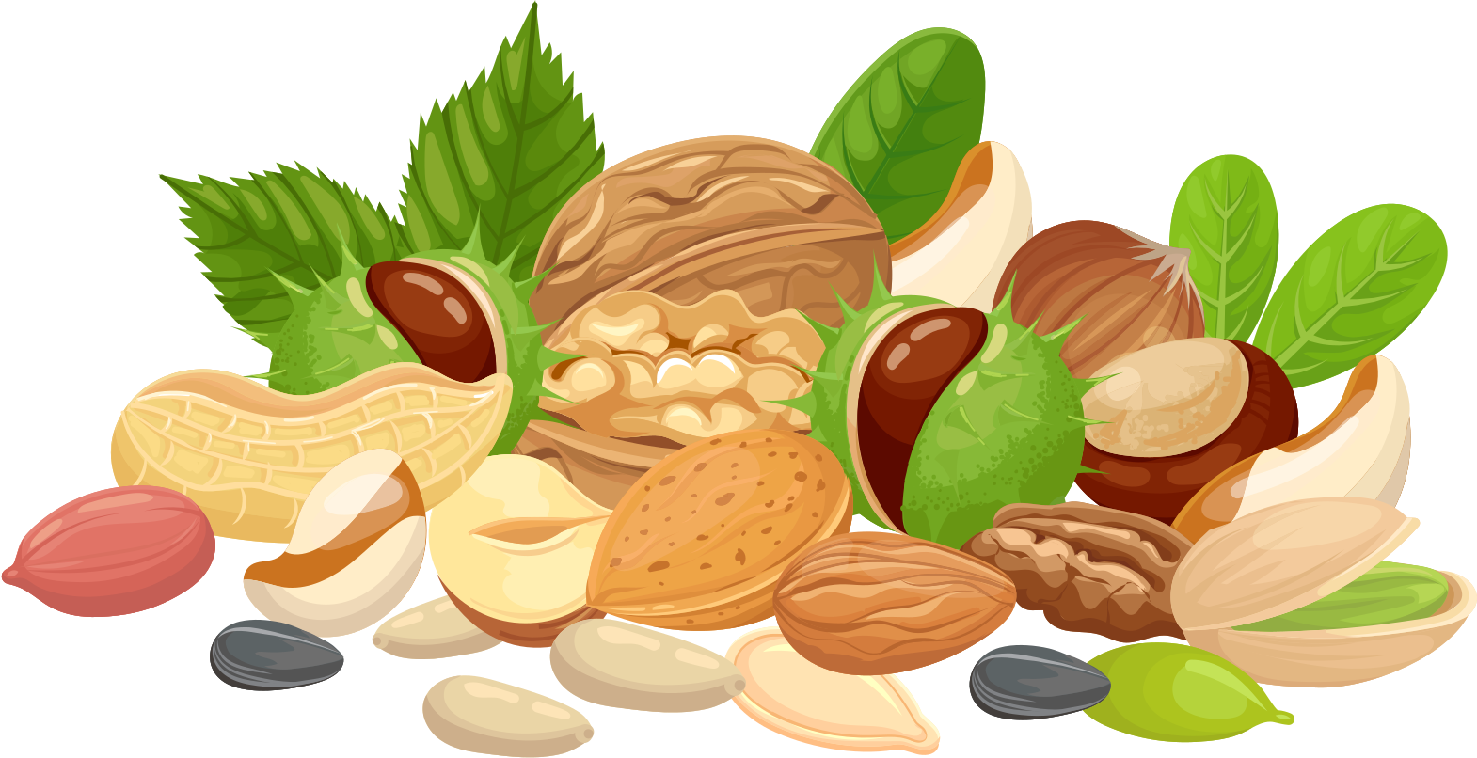








Foods high in fibre can help support your digestive system!
Fibre affects the speed of digestion, absorption of nutrients, movement of waste products (e.g. your poo) and helps feed beneficial bacteria in your intestines.
VEGETABLES
FRUITS
NUTS AND SEEDS
CARBOHYDRATES
BEANS AND PULSES
Notes:
https://health.cornell.edu/sites/health/files/pdf-library/fiber-digestion-health.pdf

Slide 5
GUESS WHICH FOOD HAS THE HIGHEST FIBRE CONTENT...

Slide 6



Which has the most fibre?
1
  2
  3
Freshly squeezed orange Juice
(150ml)
A small orange
(100g)
Smoothie
(150ml)
Information retrieved from government data set by adding together NSP and AOAC Fibre (McCance_Widdowsons_Composition_of_Foods_Integrated_Dataset_2021..xlsx (live.com))

Slide 7
The answer is the Orange!
Well done if you got it right!
The orange has the most fibre, when it is blended or squeezed into liquids (like the orange juice or smoothie), you don’t benefit from as much fibre!
  1
2
  3
Freshly squeezed orange juice
0.1g of fibre
An Orange
2.9g of fibre
Smoothie
1.5g of fibre
Information retrieved from government data set by adding together NSP and AOAC Fibre (McCance_Widdowsons_Composition_of_Foods_Integrated_Dataset_2021..xlsx (live.com))

Slide 8

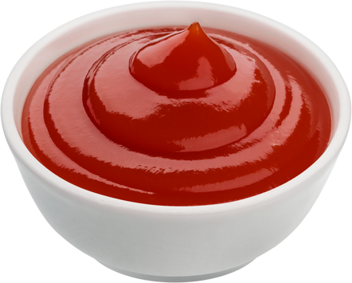

Which has the most fibre?
1
  2
  3
Fish Fingers
(80g)
Tomato ketchup
(10g)
Peas
(60g)

Slide 9
The answer is the Peas!
Well done if you got it right!
This is why peas are such a good edition to your fish and chips (or Veggie Fingers/ Quorn Dippers), as they add lots of fibre to your plate!
  1
2
  3
Fish Fingers
2.9g of fibre
Tomato ketchup
0.2g of fibre
Peas
5.8g of fibre
Information retrieved from government data set by adding together NSP and AOAC Fibre (McCance_Widdowsons_Composition_of_Foods_Integrated_Dataset_2021..xlsx (live.com))

Slide 10
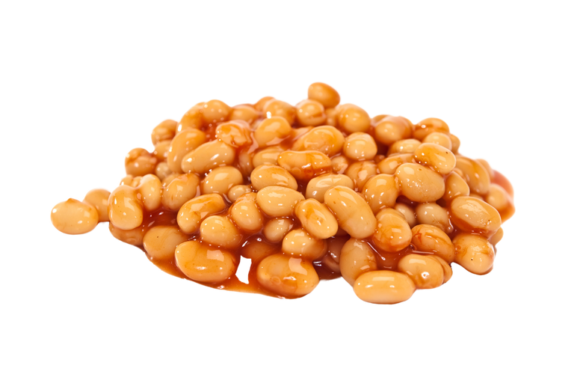
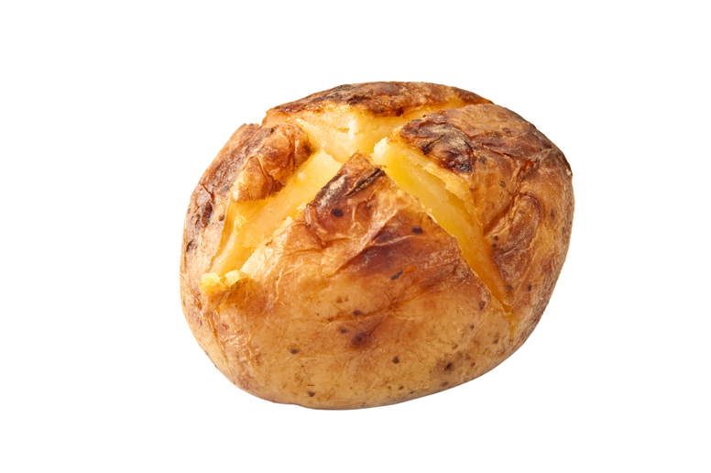
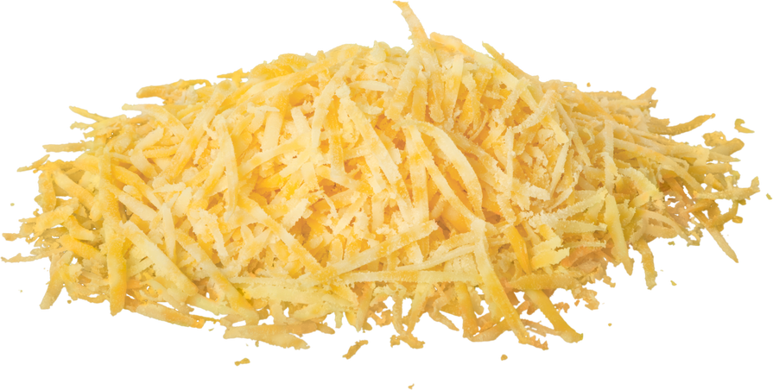
Which has the most fibre?
1
  2
  3
Baked Beans
(70g)
Cheese
(30g)
Jacket Potato
(280g)

Slide 11
The answer is the Jacket Potato!
Well done if you got it right!
BUT! Having a serving of baked beans with your jacket potato and cheese is a great way to boost your fibre! Baked Beans can also count toward your 5 a day!
  1
2
  3
Baked Beans
6.1g of fibre
Cheddar Cheese
0g of fibre
Jacket Potato
10.1g of fibre
Information retrieved from government data set by adding together NSP and AOAC Fibre (McCance_Widdowsons_Composition_of_Foods_Integrated_Dataset_2021..xlsx (live.com))

Slide 12
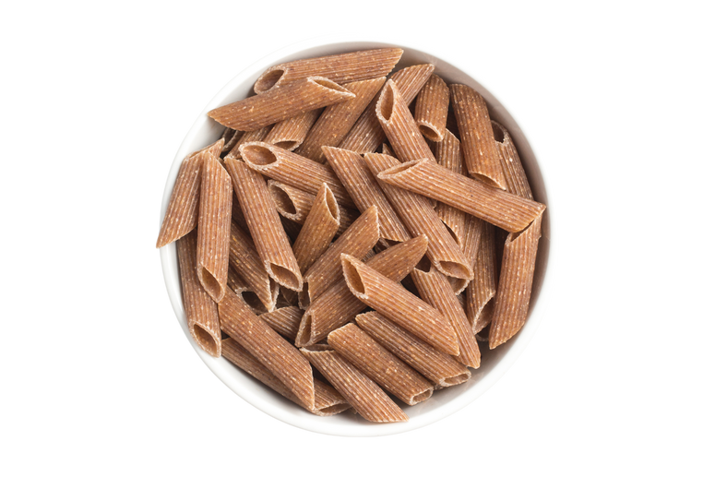
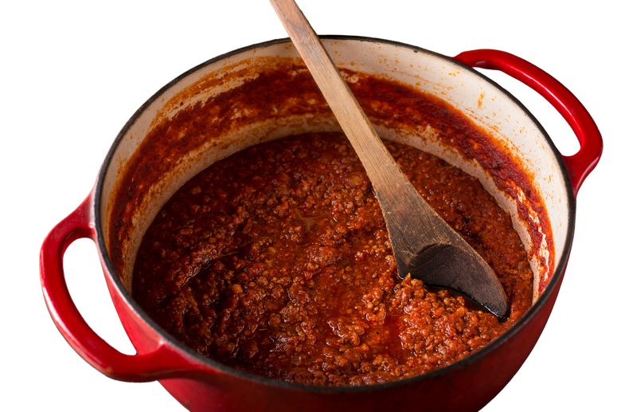
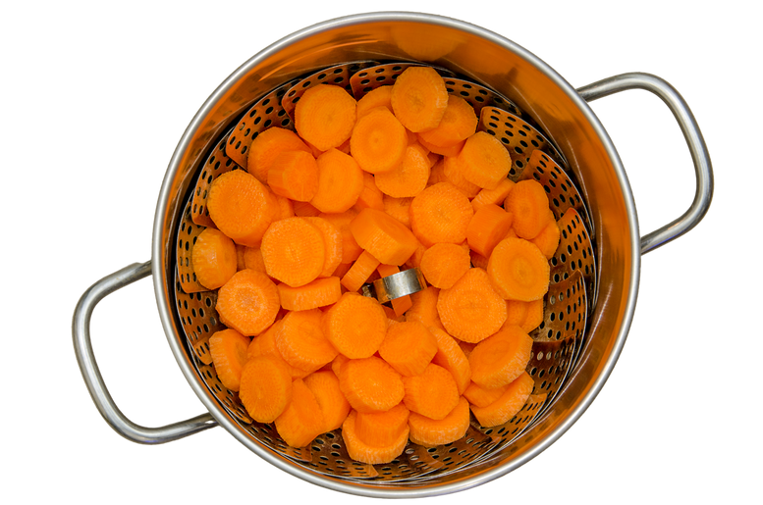
Which has the most fibre?
1
  2
  3
Beef Bolognese Sauce
(75g)
Wholegrain Pasta
(180g)
Carrots
(60g)

Slide 13
The answer is the Wholegrain Pasta!
Well done if you got it right!
Wholegrain pasta (and other wholegrain carbohydrates) contain higher levels of fibre than the white varieties, make sure you give them a go at lunch!
  1
2
  3
Beef Bolognese Sauce
1g of fibre
Wholegrain Pasta
15.5g of fibre
Carrots
2.9g of fibre
Information retrieved from government data set by adding together NSP and AOAC Fibre (McCance_Widdowsons_Composition_of_Foods_Integrated_Dataset_2021..xlsx (live.com))

Slide 14
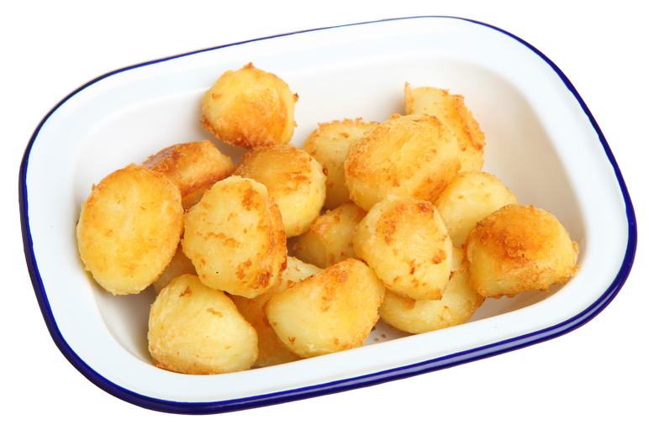
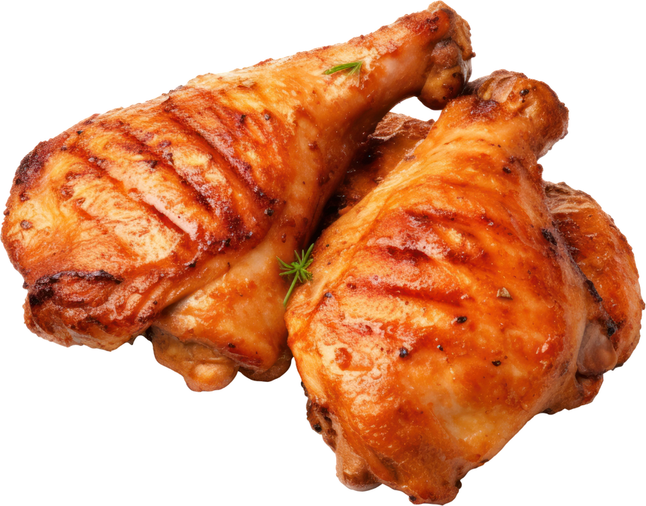
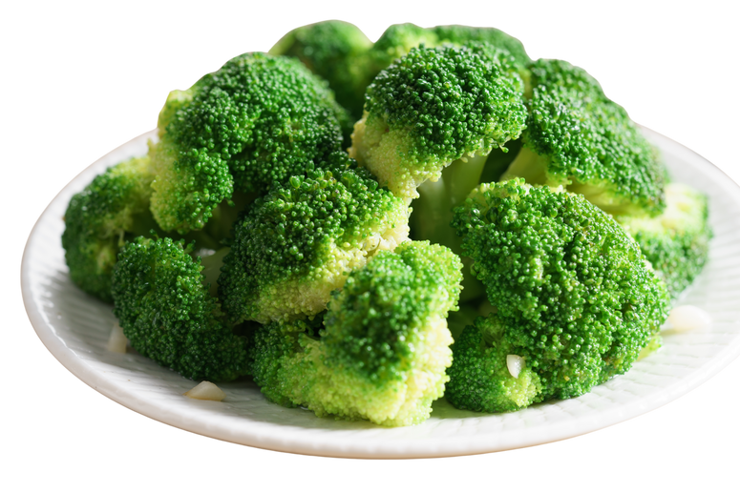
Which has the most fibre?
1
  2
  3
Roast Potatoes
(100g)
Roast Chicken
(85g)
Brocolli
(60g)

Slide 15
The answer is the Broccoli!
Well done if you got it right!
Did you know that the head of a broccoli is loads of unopened flowers? Make sure you take a good look next time you are served it for lunch!
  1
2
  3
Roast Potatoes
3.8g of fibre
Roast Chicken
0g of fibre
Broccoli
3.84g of fibre
Information retrieved from government data set by adding together NSP and AOAC Fibre (McCance_Widdowsons_Composition_of_Foods_Integrated_Dataset_2021..xlsx (live.com))

Slide 16
At lunch, try eating all your veggies to boost your fibre...

