Slide 1


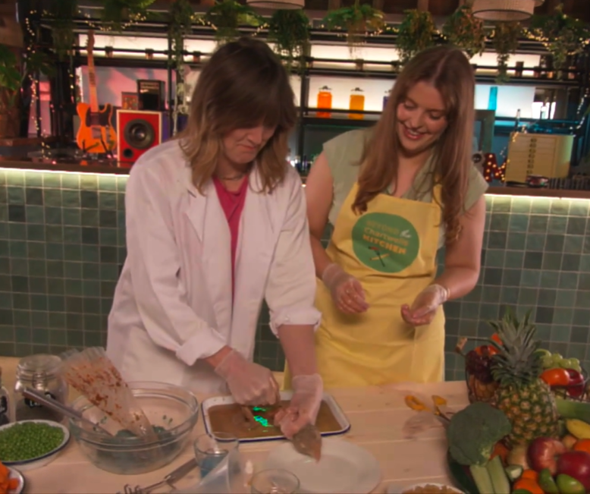


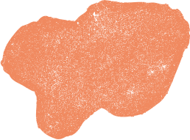
CAN YOU REMEMBER?
Let’s see if we can test your memory, and see if you can remember some of the key points from the videos.
Then you will expand on your knowledge!

Slide 2
ORGAN IDENTIFICATION
QUIZ

Slide 3

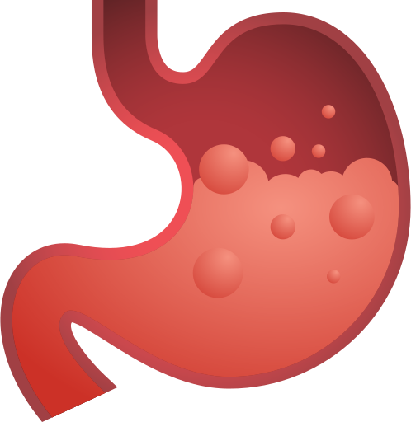

Can you Identify this organ?
1
  2
  3
Small Intestine
Large Intestine
Stomach

Slide 4

The answer is Stomach!
Well done if you got it right!
The stomach mixed your food with acids and enzymes to help digest your food. When it leaves your stomach, the food mass will now be called ‘chyme’, which means partly indigested food!
1
  2
  3
Small Intestine
Large Intestine
Stomach

Slide 5
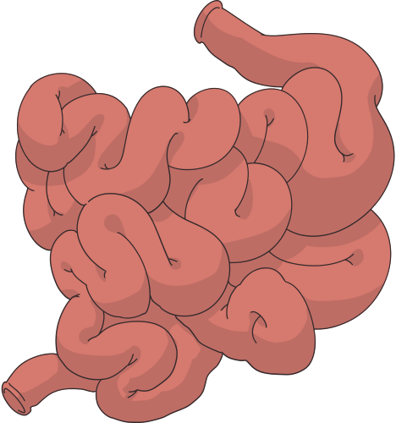
Can you Identify this organ?
1
  2
  3
Small Intestine
Large Intestine
Oesophagus

Slide 6
The answer is small instestine!
Well done if you got it right!
The small instestine will break your food down even further and absorb the nutrients, including the vitamins, minerals, carbohydrates, fats, and proteins from food! It is a long and narrow tube.
1
  2
  3
Small Intestine
Large Intestine
Oesophagus

Slide 7
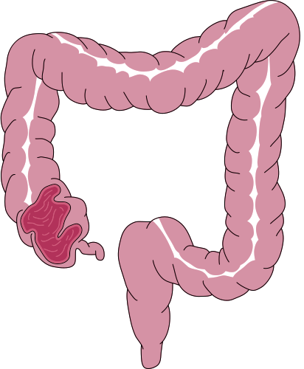
Can you Identify this organ?
1
  2
  3
Mouth
Large Intestine
Oesophagus

Slide 8
The answer is large intestine!
Well done if you got it right!
The large intestine removes excess water and ferments fibres through your gut microbiome (bacteria)! It is called the large intestine because it is wider than the small intestine (which is longer and narrower).
1
  2
  3
Mouth
Large Intestine
Oesophagus

Slide 9

Can you Identify this organ?
1
  2
  3
Mouth
Anus
Oesophagus

Slide 10
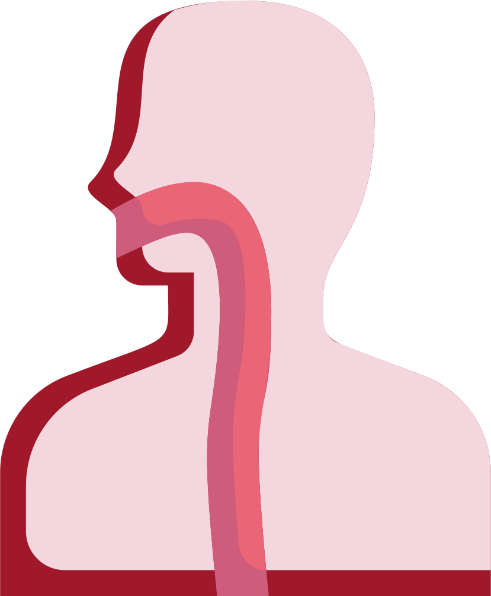
The answer is Oesophagus!
Well done if you got it right!
The oesophagus is a long pipe that connects your mouth and stomach.
Food will move through the oesophagus in peristalsis movements.
1
  2
  3
Mouth
Anus
Oesophagus

Slide 11
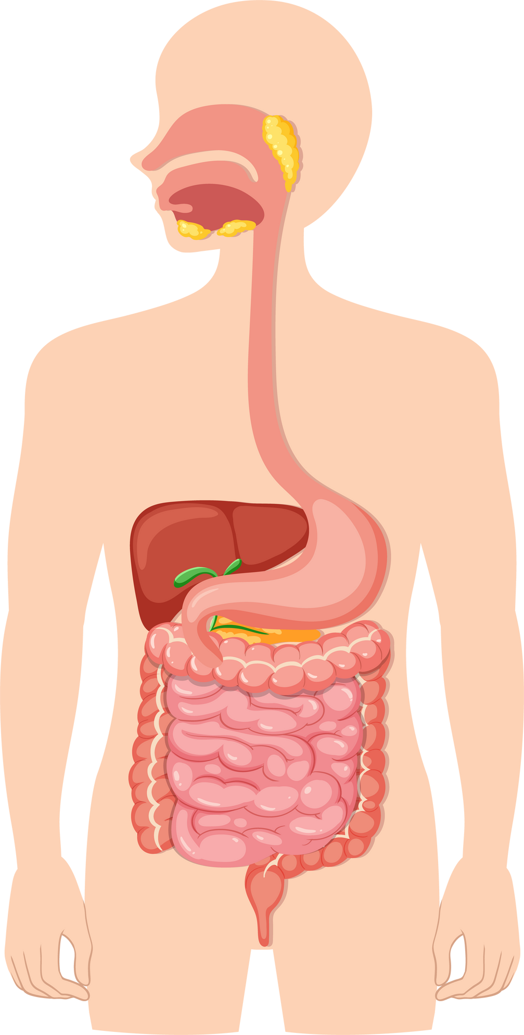









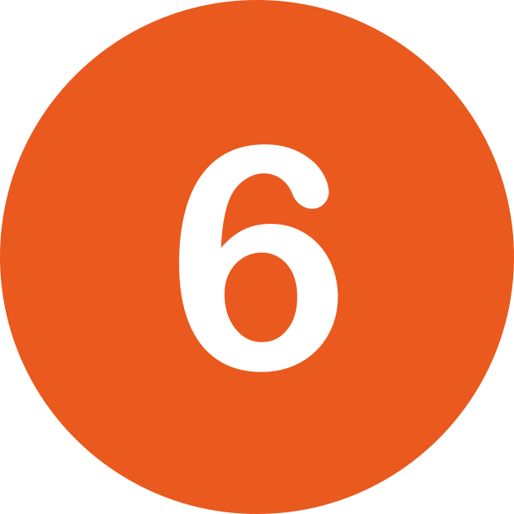
Mouth
WELL DONE!
This is the route your food takes through your body!
Oesophagus
Stomach
Small Intestine
Large Intestine
Anus

Slide 12
NOW GO AND WATCH VIDEO 3!

