Slide 1


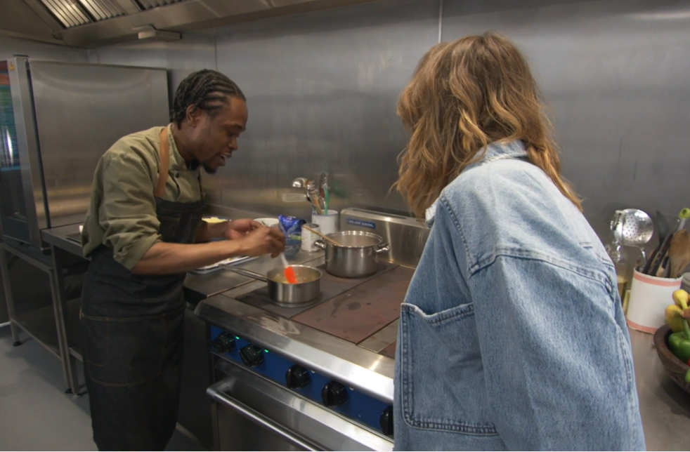


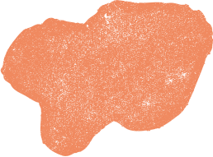
CAN YOU REMEMBER?
Let’s see if we can test your memory, and see if you can remember some of the key points from the videos.
Then we will you will expand on you knowledge!

Slide 2
QUESTION 1

Slide 3

We have to cook food for safety.
Is this statement true or false?
TRUE
  FALSE
All foods have to be cooked
Not all foods have to be cooked

Slide 4
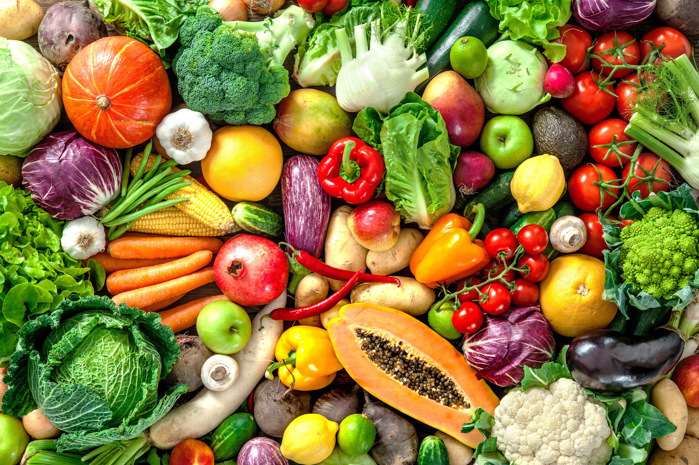

The answer is FALSE!
Not all foods have to be cooked for safety!
TRUE
  FALSE
All foods have to be cooked
Not all foods have to be cooked
Lots of fruits and vegetables can be eaten raw

Slide 5
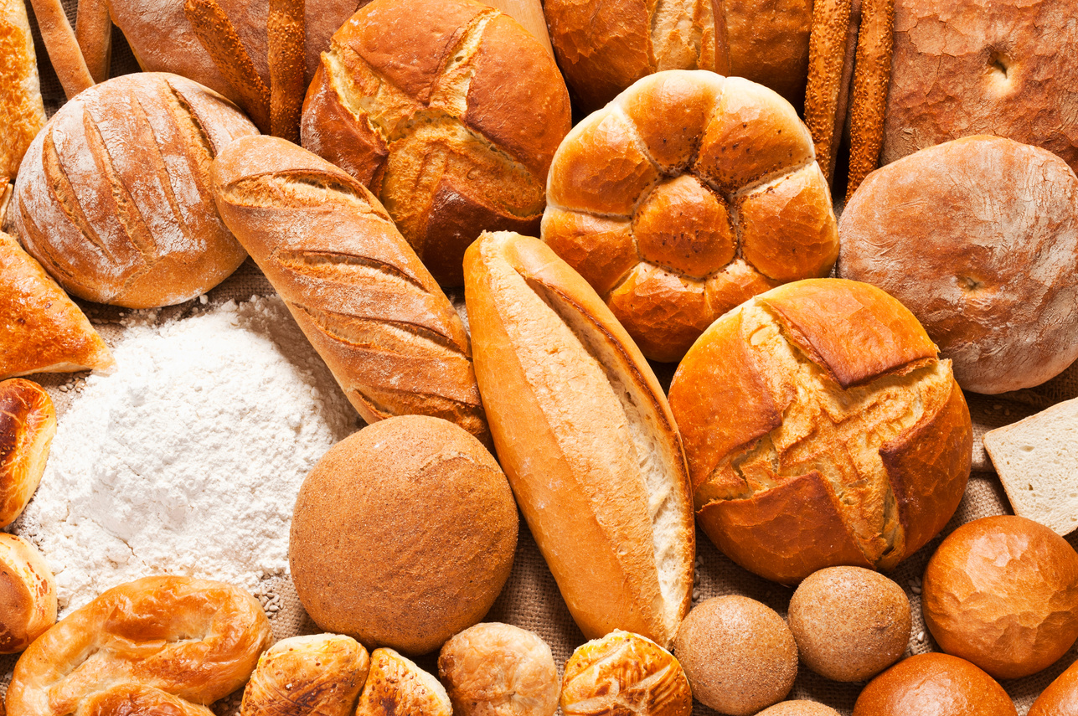


Cooking foods can be important for the reasons below...
TRANSFORMING INGREDIENTS
SAFETY
ALTERING FLAVOURS
Some foods might not be safe to eat raw, like lots of meats (chicken, beef, pork, fish). Cooking can help kill harmful bacteria.
Cooking foods can also change the flavour. Have you ever eaten a raw onion in comparison to a cooked one? The flavours are completely different.
Mixing ingredients together and them cooking them can make some of our favourite foods, like bread, cakes or pasta!
But foods such as some fruits and vegetables do not need to be cooked or undergo any processing for safety

Slide 6
QUESTION 2

Slide 7
Where are the Villi in the digestive system?
1
  2
  3
The stomach
The small intestine
The large intestine

Slide 8
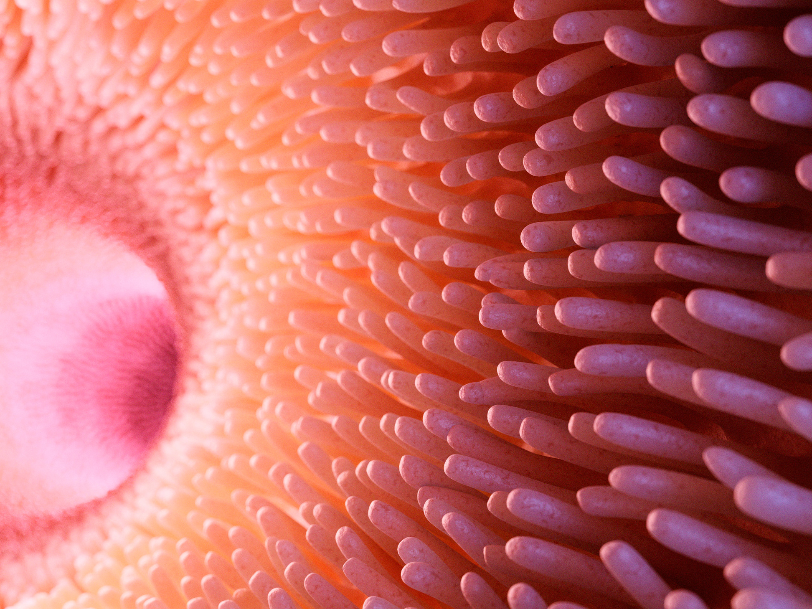
The answer is the small intestine!
Well done if you got it right!
  1
2
  3
The stomach
The small intestine
The large intestine

Slide 9
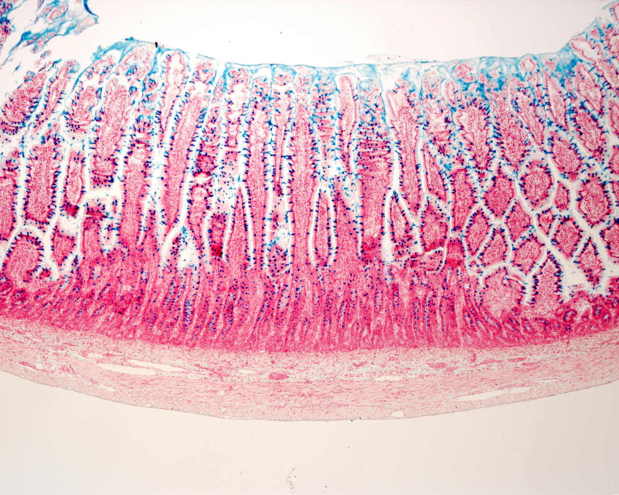
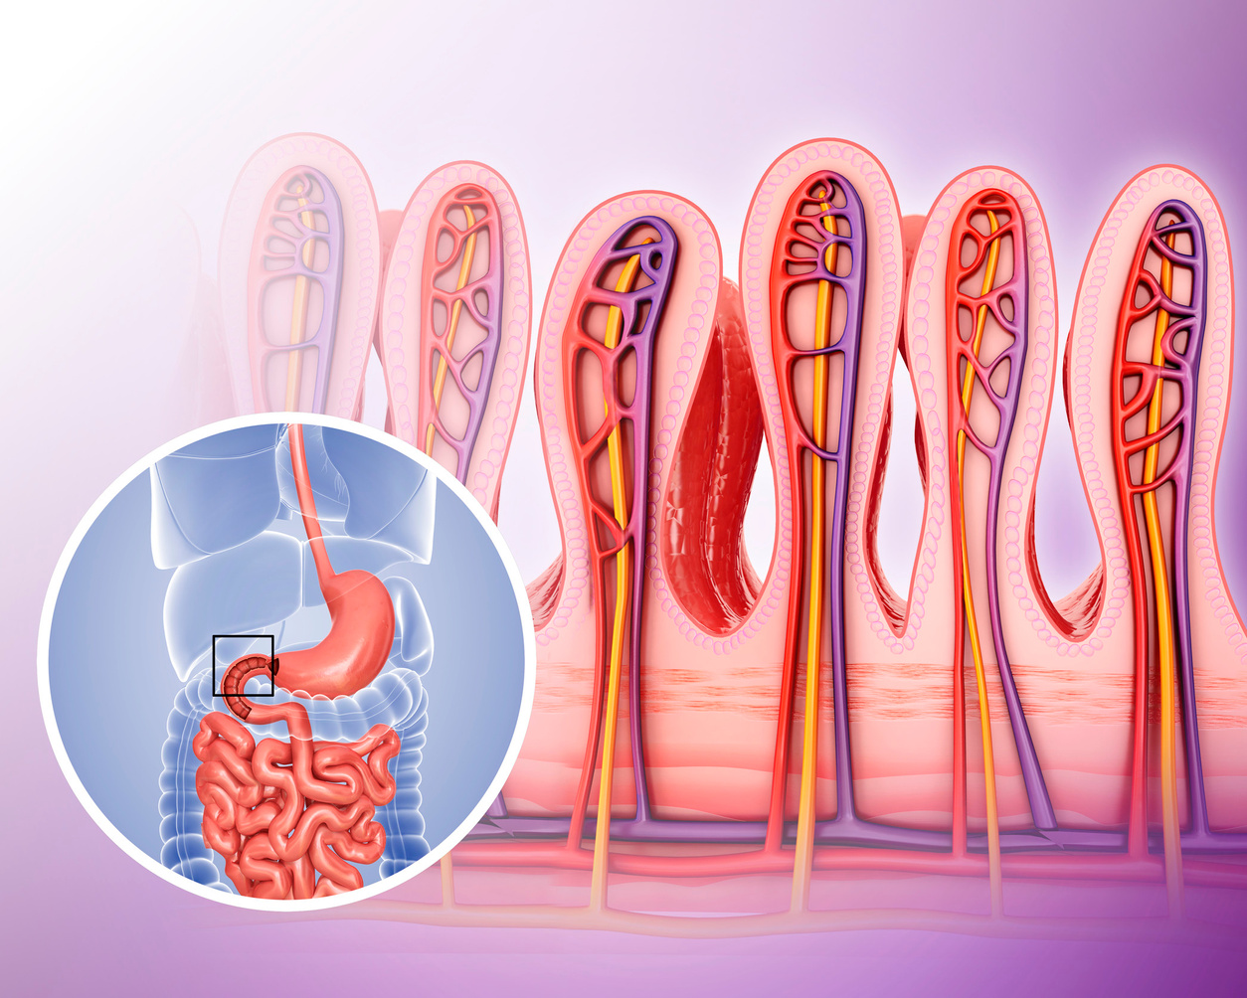
Lets learn about villi!
The villi are in the small intestine.
They absorb nutrients into the blood stream to deliver nutrients to cells in your body.
This process is called ‘diffusion’.
Their finger-like appearance allow for more surface area for nutrients to absorb.

Slide 10
QUESTION 3

Slide 11
As a class, can you decide which food groups can support your digestive system?
1
  2
  3
Vegetables
Fruit
Meat
4
  5
  6
Carbohydrates
Fats
Beans and Pulses

Slide 12
Well done if you said any of the answers below!
1
  2
  3
Vegetables
Fruit
Meat
4
  5
  6
Carbohydrates
Fats
Beans and Pulses

Slide 13
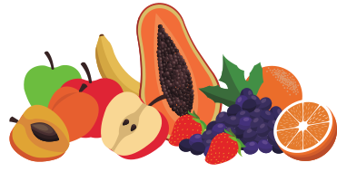
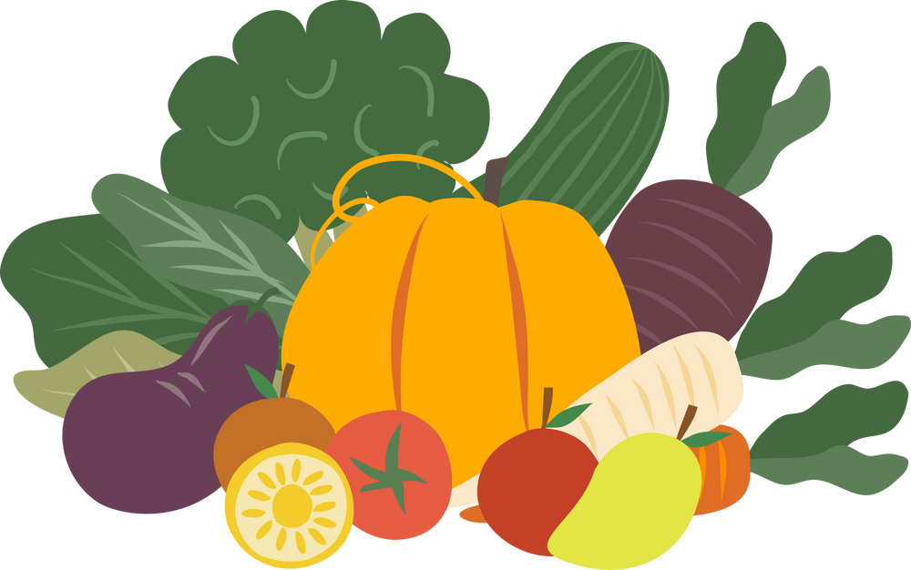
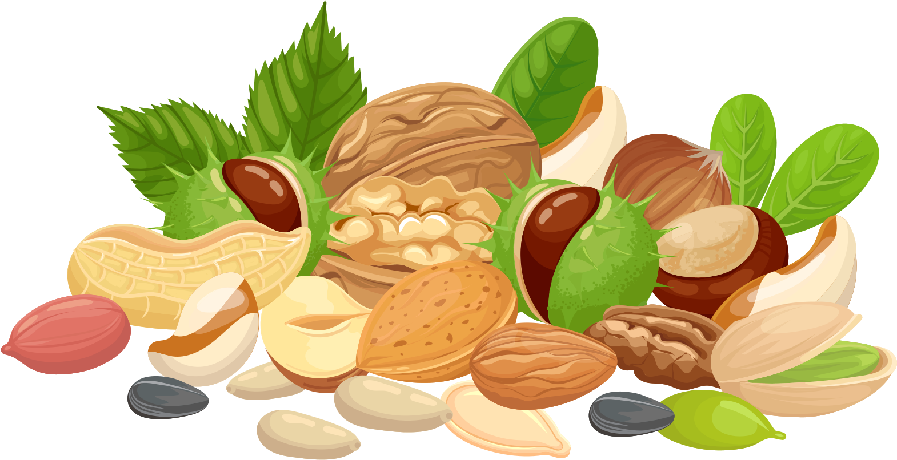
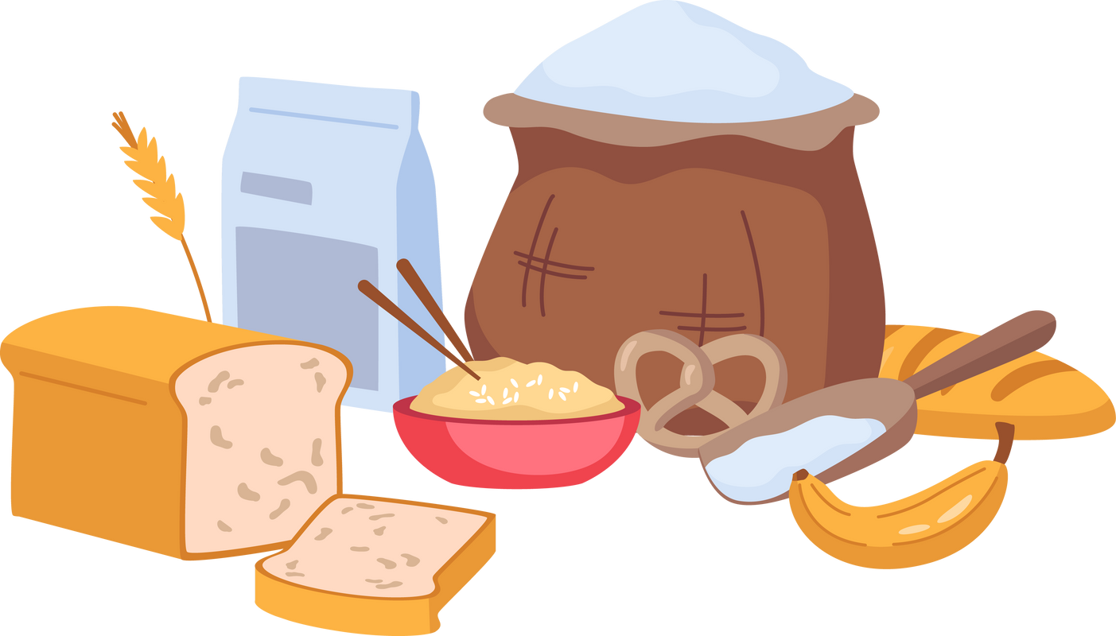
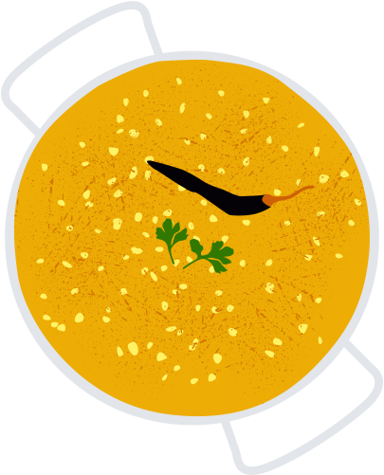






Foods high in fibre can help support your digestive system!
Fibre affects the speed of digestion, absorption of nutrients, movement of waste products (e.g. your poo) and helps feed beneficial bacteria in your intestines.
VEGETABLES
FRUITS
NUTS AND SEEDS
CARBOHYDRATES
BEANS AND PULSES
Notes:
https://health.cornell.edu/sites/health/files/pdf-library/fiber-digestion-health.pdf

Slide 14
AIM TO BE THE HEALTHIEST VERSION OF YOU...
THE END!

