Slide 1


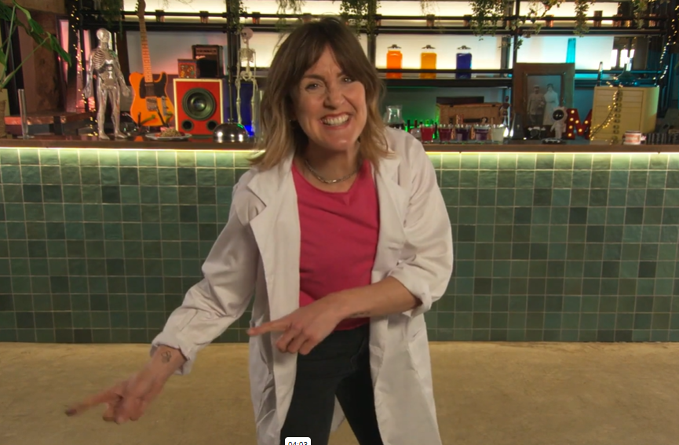


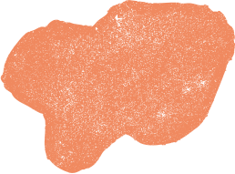
CAN YOU REMEMBER?
Let’s see if we can test your memory, and see if you can remember some of the key points from the videos.
Then you will expand on your knowledge!

Slide 2
TEETH QUIZ

Slide 3

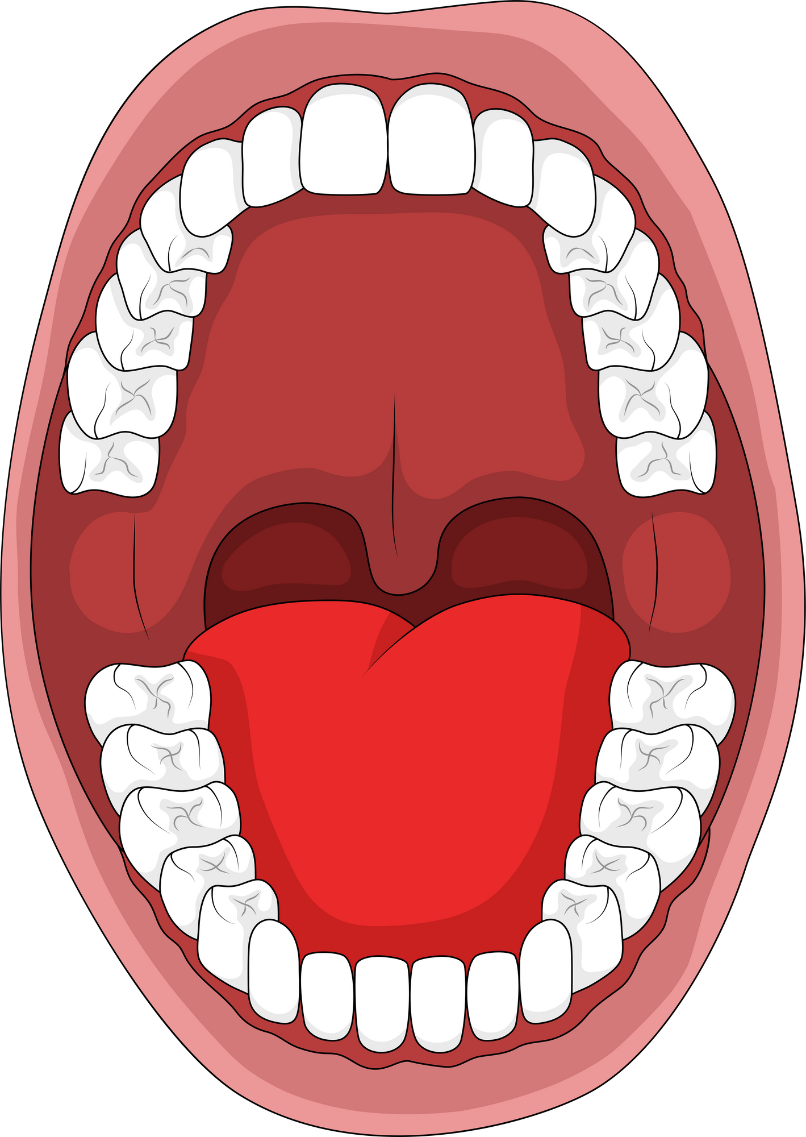



Can you identify this tooth?
Hint - This tooth help with the cutting and chopping of food
1
  2
  3
Incisor
Molar
Canine

Slide 4
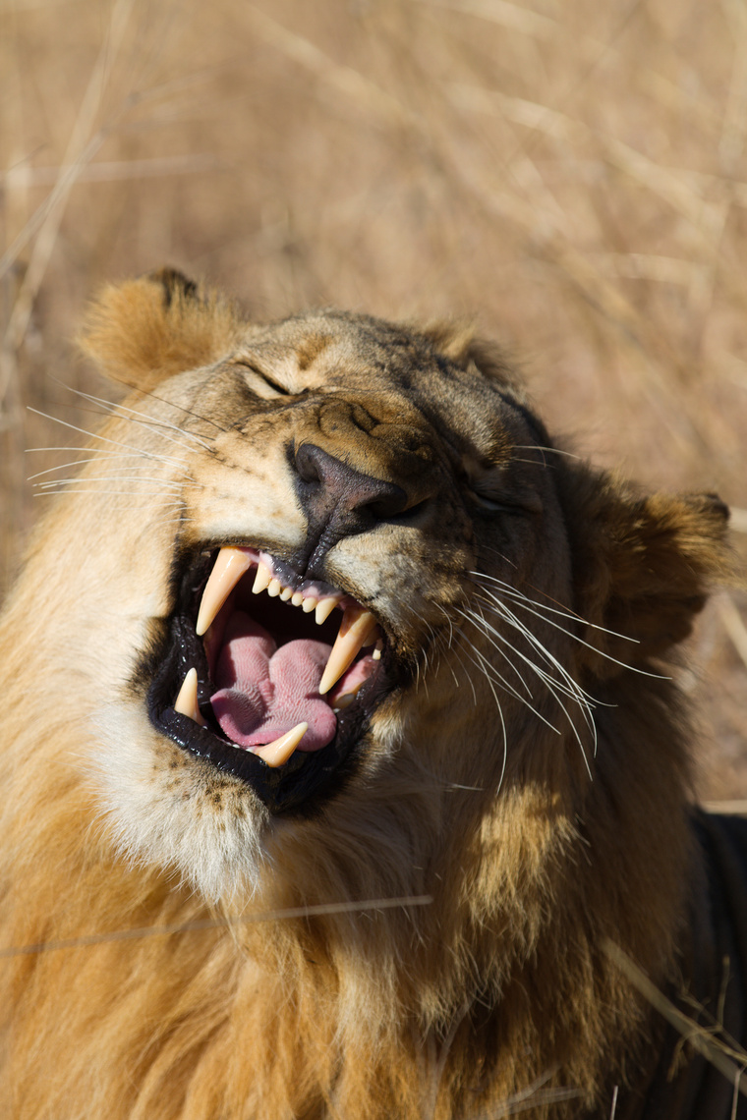

The answer is canines!
Well done if you got it right!
Canines are great for biting and tearing food...
You might recognise some animals have large canines, like lions and dogs!
1
  2
  3
Incisor
Molar
Canine

Slide 5
Can you identify this tooth?
Hint - This tooth helps us grind and crush food
1
  2
  3
Premolars
Molar
Canine

Slide 6
The answer is Molars!
Well done if you got it right!
Molars are great for grinding up food, that's why they are so flat...
You will be able to feel them with your tongue at the back of your mouth!
1
  2
  3
Pre Molars
Molar
Canine

Slide 7
Can you identify this tooth?
Hint - This tooth helps us chew and crush food
1
  2
  3
Premolar
Molar
Canine

Slide 8
The answer is Premolar!
Well done if you got it right!
Premolars are also called ‘bicuspids’ and are located between your canines and molars!
1
  2
  3
Premolar
Molar
Canine

Slide 9
Can you identify this tooth?
Hint - This tooth help you cut into foods when you first take a bite
1
  2
  3
Canine
Molar
Incisor

Slide 10
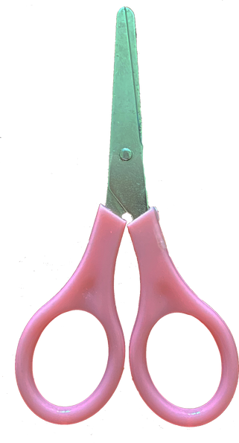
The answer is Incisor!
Well done if you got it right!
Incisors are great for chopping and cutting foods...
The word incisor is similar to scissors, which may help you remember the cutting action?
1
  2
  3
Canine
Molar
Incisor

Slide 11




WELL DONE!
To help break up your food, you have 4 different types of teeth!
Canines
Incisors
Premolars
Molars

Slide 12
ONE FINAL QUESTION!

Slide 13
What is the first stage of the digestive system?
1
  2
  3
The Stomach
The Mouth
The Intestines

Slide 14
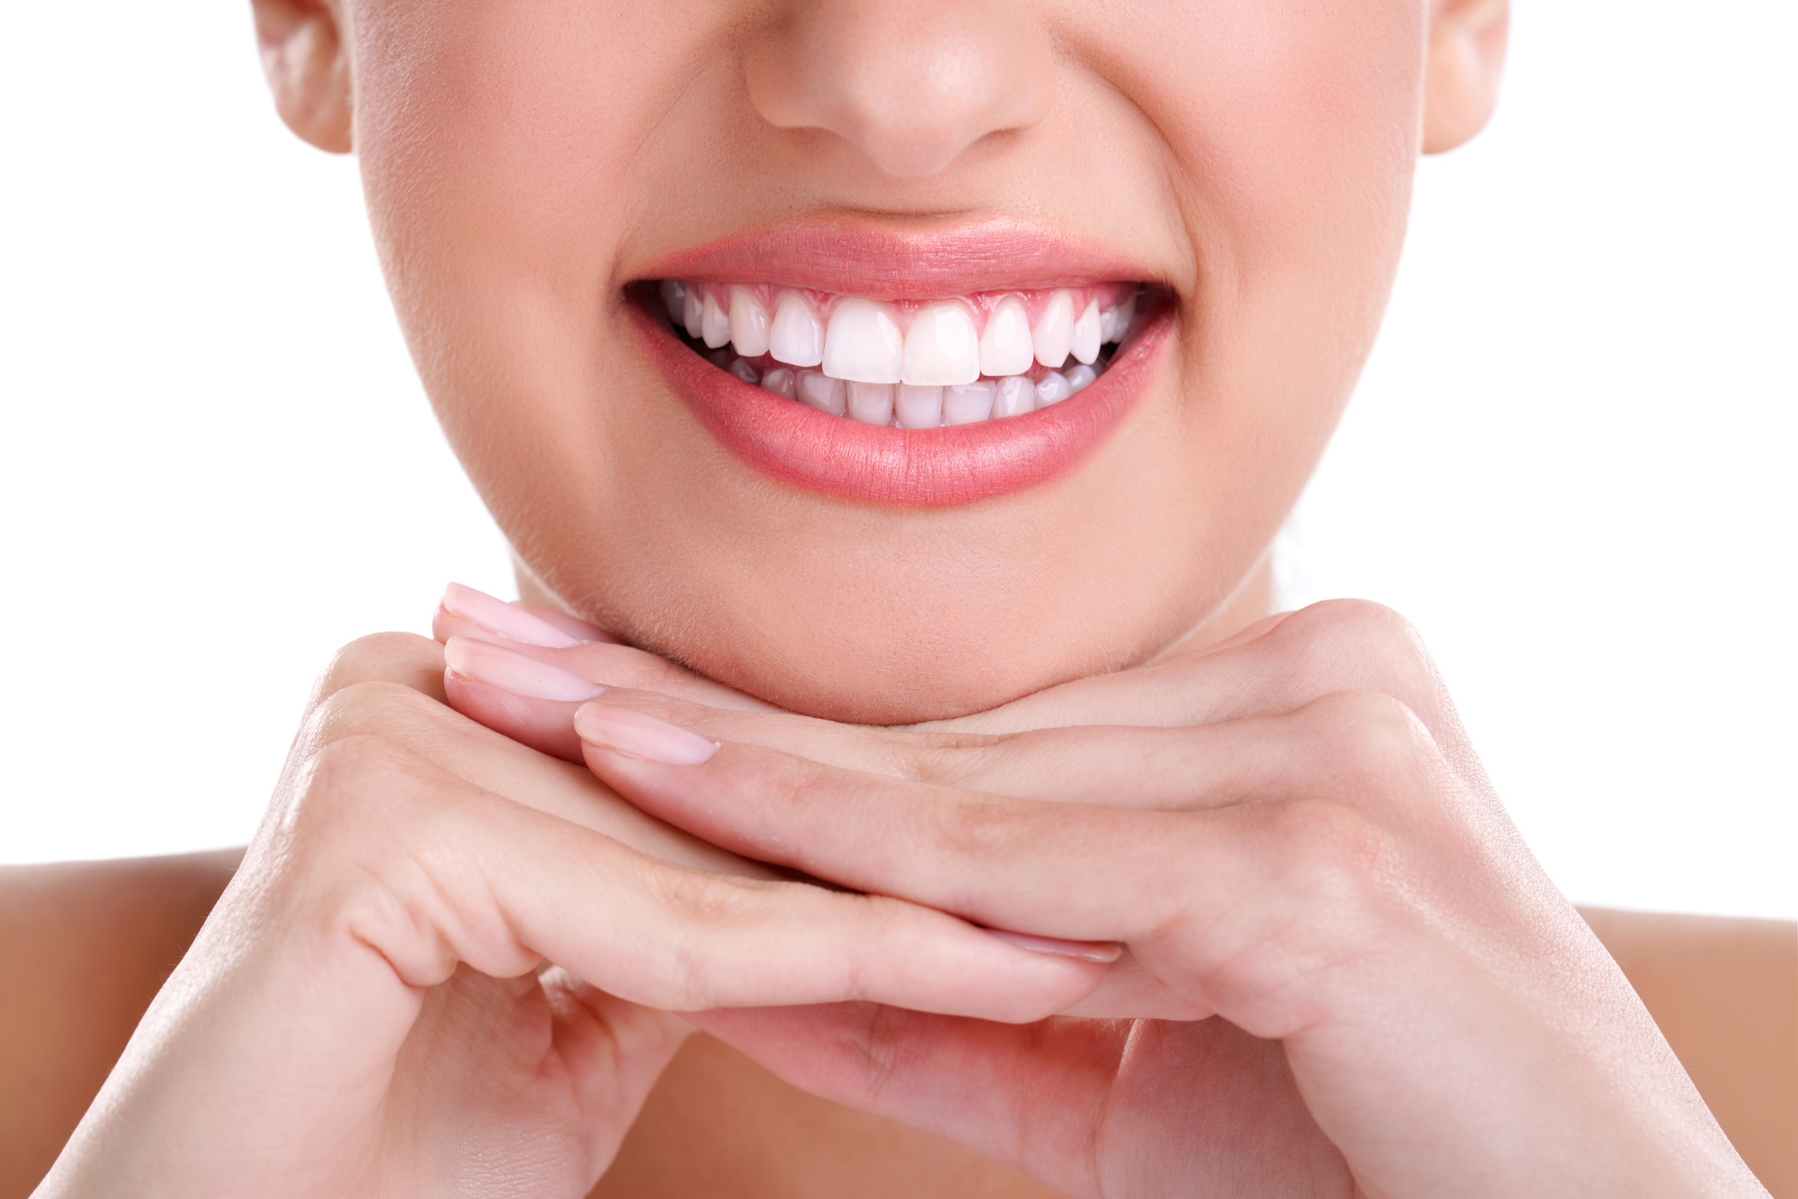

The answer is the Mouth!
Well done if you got it right!
1
  2
  3
The Stomach
The Mouth
The Intestines

Slide 15
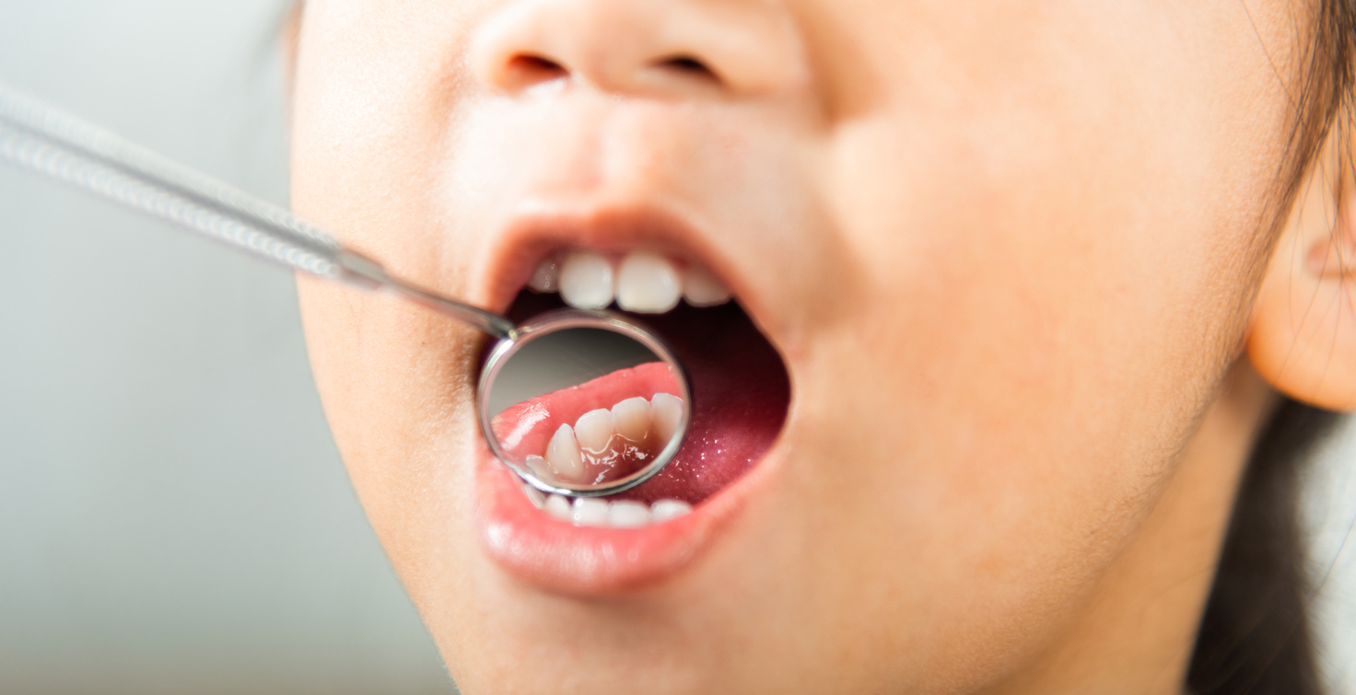
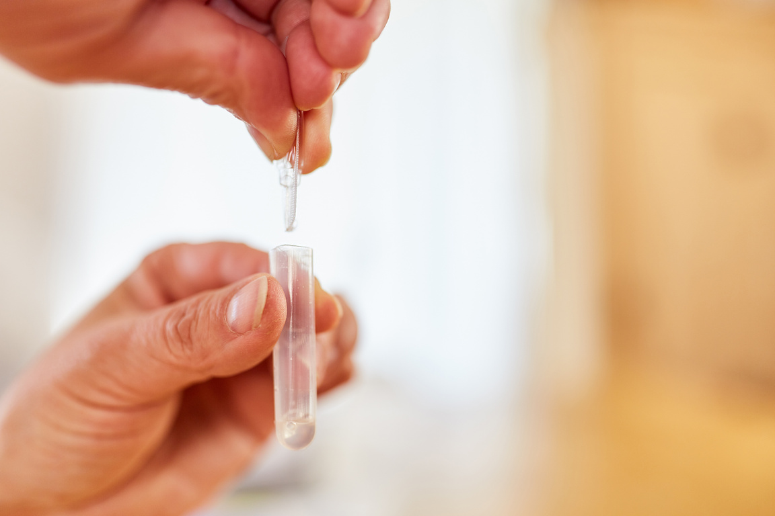

Your teeth help grasp, tear, rip and crush up your food into smaller pieces
Your mouth is where digestion begins!
Saliva in your mouth mixed with your food to moisten it, which also contains an enzyme (called amylase) which helps break carbohydrates into sugar.
Your tongue helps to move food around in mouth and push your food to the back of your mouth to be swallowed.

Slide 16
NOW GO AND WATCH VIDEO 2!

